Slide 1
Detailed Design Presentation
Children Books
Gen AI
Philipp PETER - 49004549
Maja Sofie KIRSCHNICK - 49004549
You-Jin KIM - 49004572
Agustina ROMERO RODAS - 49004595

Slide 2
Introduction
Problem Description
Traditional children's books often lack interactivity
Competition with multimedia experiences
Static narratives may not engage young readers
Solution Description
Interactive Elements: Sound effects for immersive experience, Reader choices impact the story
QR Code Integration: Access images for depth
User-Friendly Interface: Animated page transitions for engagement
Multiple Endings: Happy and child-friendly sad endings, explanations for understanding choices

Slide 3
Requirements
Functional
Non-functional
Interactivity
Image Generation (SDXL)
Text Creation
Background Audio
Translation (Argos)
Responsive UI Design
Multiple Endings
Reliability
Scalability
Accessibility
Data Privacy
Testing and Quality Assurance
Legal and Copyright Compliance

Slide 4
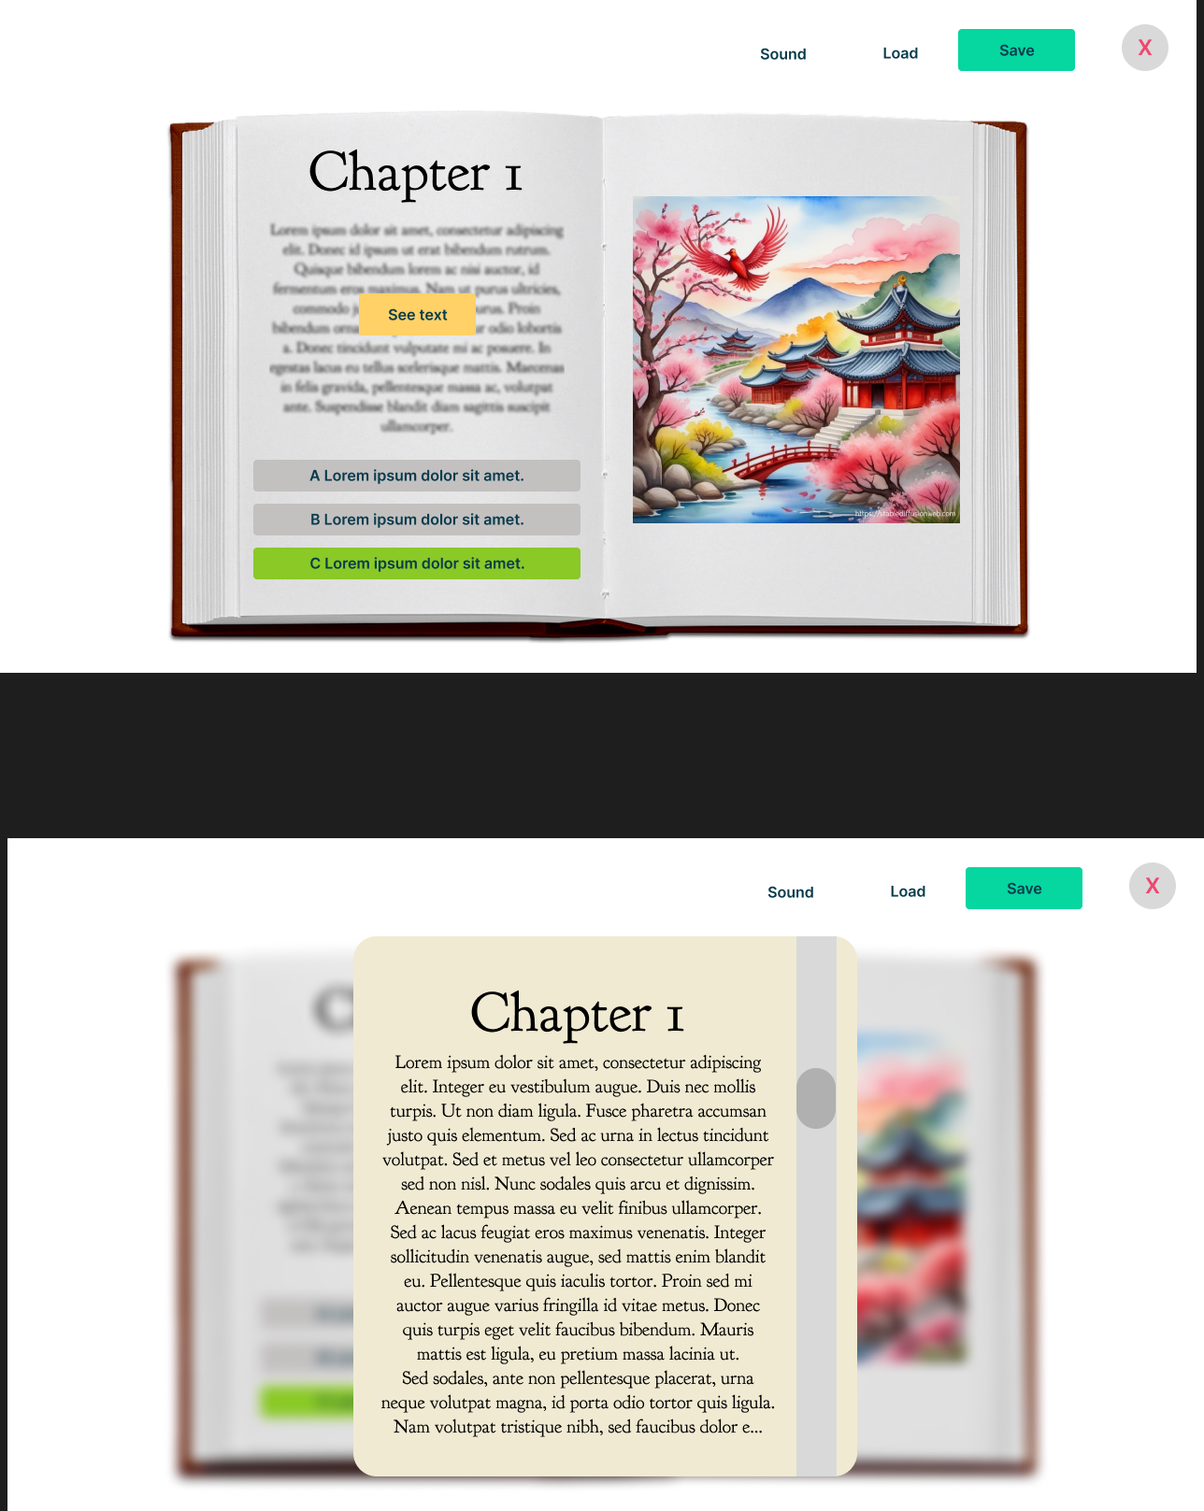



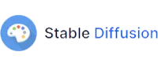

High Level Architecture
Front-End
Back-End

Slide 5
Front-End Architecture

Slide 6
Front-End Architecture
User specific
Input data
Back-End
Loop for n times
Generated Text
Generated Decisions
Generated Image
Generated Sound
Choosing Decision
A, B, or C

Slide 7
Back-End Architecture
Front-End
User specific
Input data
Language specific input
Generated Text
translated text
Generated Decisions
English text
English Input
Generated Image
Generated Sound
Choosing Decision
A, B, or C
Audio Prompt
Image Prompt
Sound File
as WAV
Image as PNG

Slide 8
Back-End Architecture
Argos Translate [1]
Language specific input
translated text
Input
text from over 40 different languages
English text
English Input
Translate to English
Text to LLM (Mistral)
LLM-generated English Text
Audio Prompt
Image Prompt
Sound File
as WAV
Translate to specific language
Output
Text in chosen language
Image as PNG

Slide 9
Back-End Architecture
Mistral 7B LLM [2]
Language specific input
translated text
Series of powerful, adaptable, and user-friendly AI models
7 billion parameters
Supports English and coding
Optimized for low latency
Capabilities: Text summarization, classification, text and code completion
English text
English Input
Audio Prompt
Image Prompt
Sound File
as WAV
Image as PNG

Slide 10
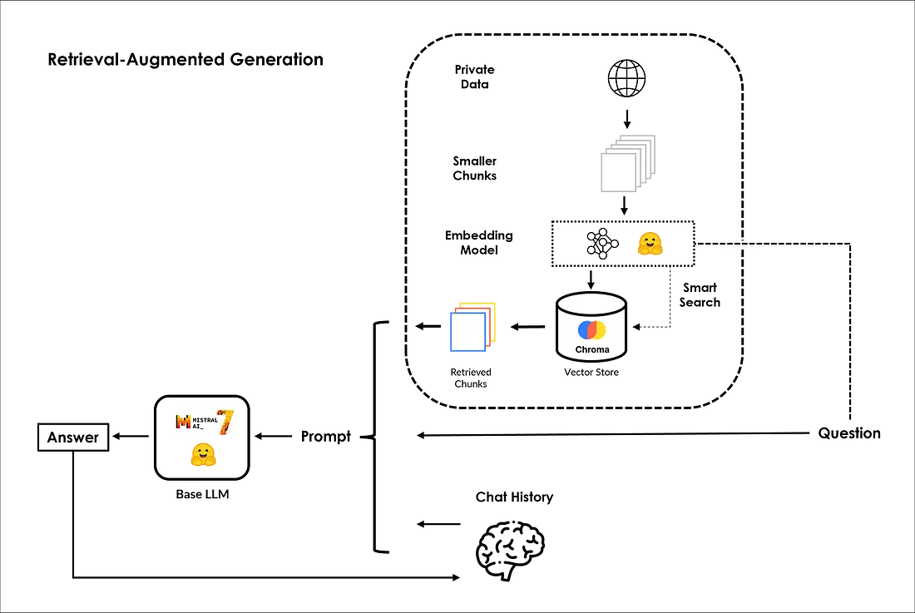

Back-End Architecture
Mistral 7B LLM [2]

Slide 11
Back-End Architecture
AudioLDM 2 [3]
Language specific input
translated text
AudioLDM 2 Implementation:
Acquire a pre-trained model from Hugging Face and integrate an audio generation control interface.
Parameters:
Prompt, Negative Prompt, Audio Length, Fade In/Out
Inputs:
Text descriptions, negative prompts, parameter values
Output:
Audio samples in WAV format
English text
English Input
Audio Prompt
Image Prompt
Sound File
as WAV
Image as PNG

Slide 12

Back-End Architecture
Stable Diffusion [4]
Language specific input
translated text
Used for Image Generation
Model:
Stable Diffusion XL
Text Prompts:
Positive, Negative
Sampling:
Sampler, Steps, CFG Scale, Seed
Others:
Width, Height, Batch Size
English text
English Input
Audio Prompt
Image Prompt
Sound File
as WAV
Image as PNG

Slide 13
Background Loading Architecture
Front-End
Back-End
Decision 1
Decision 2
Decision 3
Back-End
Back-End
Back-End

Slide 14
Resources
[1] Argos Translate, Argos Multilingual. [Online]. Available: http://www.argosopentech.com/. [Accessed: Nov. 13, 2023].
[2] Mistral AI. [Online]. Available: https://mistral.ai/. [Accessed: November 13, 2023].
[3] H. Liu, Q. Tian, Y. Yuan, X. Liu, X. Mei, Q. Kong, ..., and M. D. Plumbley, "AudioLDM 2: Learning Holistic Audio Generation with Self-Supervised Pretraining," arXiv preprint arXiv:2308.05734, 2023.
[4] R. Says, "The Most Complete Guide to Stable Diffusion Parameters," OpenArt Blog, Feb. 2023. [Online]. Available: https://blog.openart.ai/2023/02/13/the-most-complete-guide-to-stable-diffusion-parameters/. [Accessed: Nov. 13, 2023].

